Slide 1
Car Parking System
Team Members:
Muhammad Nauman Imran
Unsha Aftab

Slide 2
Introduction
Car parking System :
maintains the check for number of cars entering and leaving the barrier
Now, problem of car parking in big cities has been resolved.

Slide 3
Components:
Arduino UNO
Jumper Wires
RGB Backlight LCD 16x2
16 MHz Crystal
Linear Regulation(7805)
Resistor 2.21K ohm
Capacitor 10 micro Farad
PIR motion Sensor

Slide 4
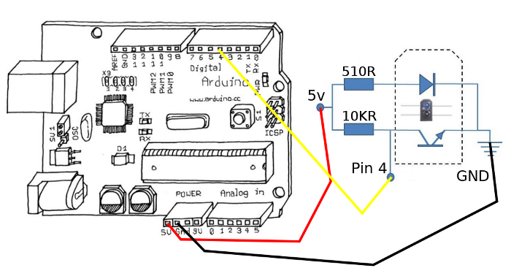
The Arduino is platform open-source hardware, based on a simple board with inputs and outputs, analog and digital, in a development environment that is based on the programming language processing. It is a device that connects the physical world with the virtual world, or the analogue world with the digital.
Circuit Diagram

Slide 5
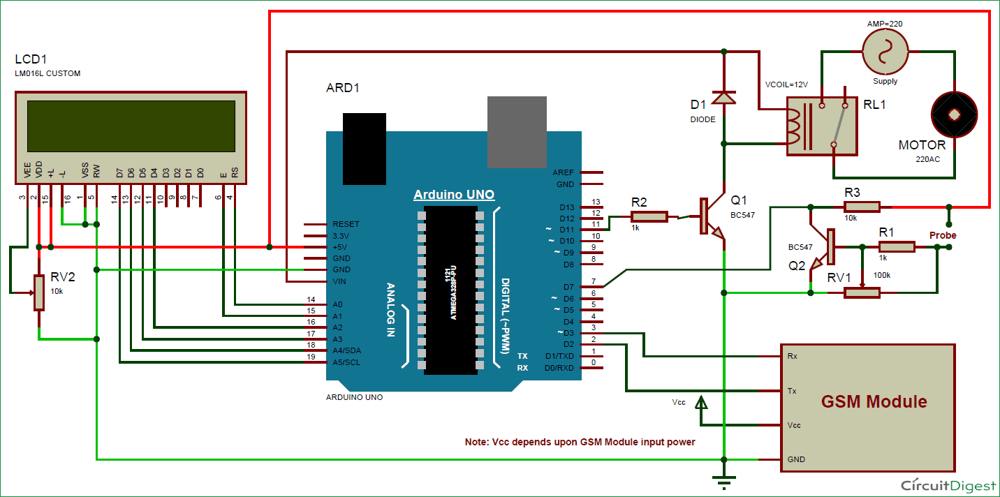
Proteus based Result:
Instead of 7 segment display, we have used LCD .

Slide 6
Conclusion
The code is booted to Arduino board using Arduino IDE. Through this project we could find out the number of cars in a parking area, number of car entering and exiting simultaneously.

Slide 7
Questions?

Slide 8
Thanks!!!

